Slide 1
THEME:
RELATIVE CLAUSES

Slide 2
TABLE OF CONTENTS
01
02
03
04
Definition
Relative pronouns and adverbs
Types of relative clauses
Types of relative clause exercises

Slide 3
01
DEFINITION

Slide 4

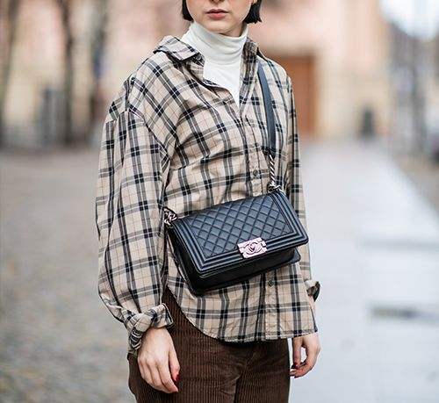
Eg1. My mother is talking to the woman who lives next door to us.
Relative clause
Eg2. The bag which she bought last week was very expensive.
Relative clause

Slide 5
I. DEFINITION
A relative clause is an adjective clause that modifies the noun coming before it in the main clause of the sentence. A relative clause begins with a relative pronoun such as who, which,.. or a relative adverb such as when, where, …. A relative clause cannot exist independently.
Relative pronoun
Eg1. My mother is talking to the woman who lives next door to us.
Relative clause
Relative pronoun
Eg2. The bag which she bought last week was very expensive.
Relative clause

Slide 6
02
RELATIVE PRONOUNS AND ADVERBS

Slide 7
Relative Pronouns and Adverbs |  | Function in Relative clause | Uses
Relative Pronouns
Relative Adverbs
who
S, O
To modify the noun denoting PEOPLE.
which
S, O
To modify the noun denoting THINGS.
that
S, O
To modify the noun denoting PEOPLE, THINGS.
whom
O
To modify the noun denoting PEOPLE.
whose
Possessive adj
To replace a Possessive Adjective.
when
Adv of time
To replace an Adverb of time.
where
Adv of place
To replace an Adverb of place.
why
Adv of reason
To replace an Adverb of reason.

Slide 8
NOTES:
1
2
3
4
5
whose: luôn đứng trước 1 danh từ.
When/where = in/on/at which
Why = for which
Chỉ có hai đại từ quan hệ có thể đứng sau giới từ: which, whom
which: có thể thay thế cho cả mệnh đề đứng trước nó
6
that: KHÔNG đứng sau dấu phẩy và giới từ.

Slide 9
NOTES:
7
Sử dụng “that” trong các trường hợp sau:
- Sau all, little, much, none, the first, the second, the last, the next, the only, etc.
Eg1. I gave her all the money (that) I had.
- Sau So sánh nhất.
Eg2. This is the longest bridge that has been built in this area.
- Sau somebody, someone, nobody, something, everything,…
Eg3. I’ve got everything that is necessary for our trip.
- Sau danh từ chỉ cả người và sự vật
Eg4. The girl and the flowers (that) he painted were so vivid.

Slide 10
03
TYPES OF RELATIVE CLAUSES

Slide 11
RELATIVE CLAUSES
DEFINING RELATIVE CLAUSES
NON-DEFINING RELATIVE CLAUSES

Slide 12

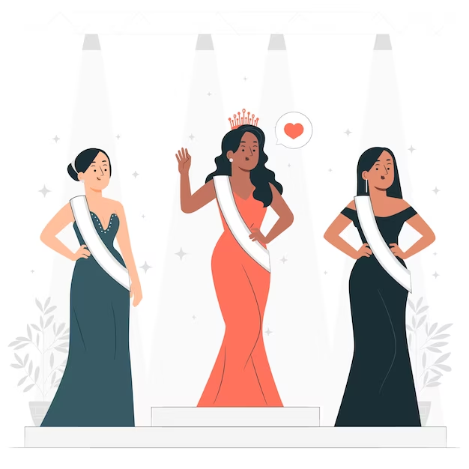
EXAMPLES
Eg1. The man is talking about his wife who has just won the first prize in a Beauty contest.
Defining Relative clause
Eg2. The man is talking about his wife, who has just won the first prize in a Beauty contest.
Non- Defining Relative clause

Slide 13
1. DEFINING RELATIVE CLAUSES (MĐQH xác định)
Use: A defining relative clause defines, explains, or specifies the thing or person we mean. It cannot be left out.
Eg1. The man is talking about his wife who has just won the first prize in a Beauty contest.
2. NON-DEFINING RELATIVE CLAUSES (MĐQH không xác định)
Use: A non-defining relative clause gives extra information to the noun before it. It is separated from the main clause by comma(s).
Eg2. The man is talking about his wife, who has just won the first prize in a Beauty contest.
Eg2. Mr. Jones, who lives in the next flat, is very humorous.

Slide 14
2. NON-DEFINING RELATIVE CLAUSES (MĐQH không xác định)
- After a noun phrase containing a demonstrative: this, that, these, those
Eg1. This doctor, who is very famous, is treating my mother.
- After a proper name: Viet Nam, Hai Phong, Mr. Tran…
Eg2. Hai Phong, which is a dynamic city, attracts a lot of
investors each year.
- After a thing or a person that is one of a kind: the sun, the moon, Mars, my father, the Town Hall...
Eg3. My father, who is 60 years old, has just retired.

Slide 15
TYPE 1: Mark the letter A, B, C, or D to indicate the correct word or phrase that completes each of the sentences
1. Laura is the woman ____ lives next door to us.
A. who B. whose C. which D. whom
2. I didn’t do well in the last test, _____ disappointed me.
whom B. which C. what D. that
3. This is Mr Nam, ______ son won first prize in the English speaking contest.
A. who B. whom C. that D. whose
4. I have bought 2 books, both of ____ were written by Dickens.
that B. whom C. which D. who
5. The chemistry book _____ was a little bit expensive.
I bought B. what I bought C. I bought that D. that I bought it

Slide 16
TYPE 2: Mark the letter A, B, C, or D to indicate the part that is incorrect.
1. The director is the man whom is wearing a suit with a red tie.
A B C D
who /that
2. Doctor Smith, that my father visited, was very patient with him.
A B C D
whom / who
3. We passed the shops which windows were decorated for Christmas.
A B C D
whose
4. Did you give the boy the candies whom I bought this morning?
A B C D
(which / that)
2. My friend whom you had dinner with him last Sunday wants to meet you.
A B C D
omitted

Slide 17
TYPE 3: Mark the letter A, B, C, or D to indicate the sentence that is BEST written from the words/phrases given
1. Driver/badly injured/accident/fine/ now.
A. The driver who was badly injured in the accident is fine now.
B. The driver which was badly injured in the accident is fine now.
C. The driver whom was badly injured in the accident is fine now.
D. The driver that he was badly injured in the accident is fine now.
2. Auld Lang Syne / a song / is sung / New Year’s Eve.
A. Auld Lang Syne is a song who is sung on New Year’s Eve
B. Auld Lang Syne is a song which is sung on New Year’s Eve
C. Auld Lang Syne is a song whom is sung on New Year’s Eve
D. Auld Lang Syne is a song what is sung on New Year’s Eve
.

